Slide 1
RoboCat- Milestone 3
ALEX VILD, QUINTIN FETTES, ZACH TAYLOR, KURTIS DAVIS, SEATTLE RUZEK, LUKE SHAYS

Slide 2
Release Process
From beginning to end:
A developer will clone a branch of the repo
Make improvements to the functionality of the cat
Test branch code on the RoboCat
Merge branch with master upon successful test
At each milestone, mark a release on github. Develop apk and upload to Google Play Store
Not uploaded to store right now. We need the account info
Notes:
Present

Slide 3
Bug Reporting Channel
All done via github issues

Slide 4
Alternative Technologies
Google Play services (Vision)
this was used in lieu of openCV. It’s simpler, better supported, and more maintainable
Used for face tracking and Color Tracking
PocketSphinx
used in addition to google API for speech. Continuous listening is not possible with only Google’s API

Slide 5

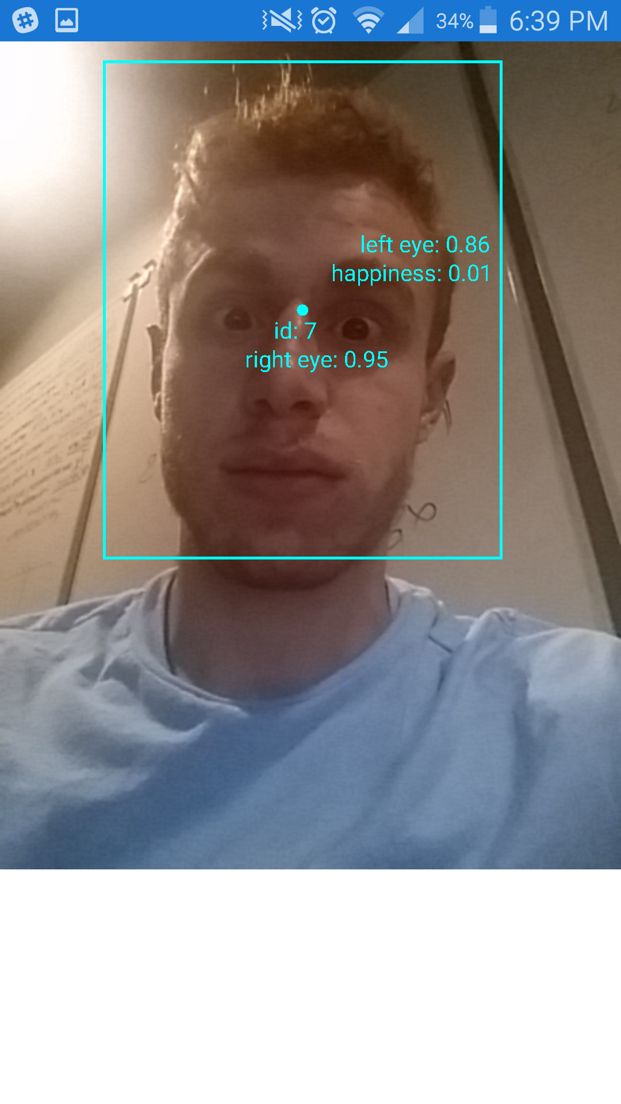


Build 3
Notes:
Don’t present - show late

Slide 6
Original Milestones
Our team was given 3 major goals for improvements to the RoboCat:
Active Speech Recognition
Facial Recognition and Tracking
Environmental Mapping
Initially, our plan was to split into 3 groups of 2 so that we could address these project requirements, with each team of 2 having sub-milestones at each group milestone.
Notes:
Present

Slide 7
Original Milestone 1 (From Sprint 1)
Group
Debug app to the point that it will compile and run on android devices
Perform a test of the current functions of the Robocat
Document and Organize Git repository
Notes:
Present

Slide 8
Original Milestone 1 (From sprint 1)
Speech Recognition Team
Document and test the accepted commands for the cat
Facial Recognition Team
Test the color tracking functionality; evaluate issues with this functionality
Environmental mapping team
Decided on a new hardware component to add to the RoboCat to assist in Environmental mapping - ultrasonic sensor.
Notes:
Present

Slide 9
Original Milestone 2 (From sprint 1)
Speech Recognition Team
Overall improved accuracy of speech recognition
Continuous listening, prompted by a keyword for commands
Facial Recognition Team
Recognize a face or faces in the environment
Recognize a user specified color in the environment
Environmental Mapping Team
Establish Communication between the Arduino board, the new hardware, the servos controller, and the phone.
Add a battery indicator using the GUI of RoboApp
Decide a method for communication between both an Arduino Board and the servos controller (whether it can be parallel or communication between servos and phone has to run through the Arduino Board
Determine how accelerometer data is logged.
Notes:
Present

Slide 10
Original Milestone 3 (From sprint 1)
Speech Recognition Team
Accurate recognition of all existing commands; additional command will be added
Begin implementing emotion detection based upon volume/tone of voice
Facial Recognition Team
The cat will be able to move its head to center a recognized face in its field of view
the head to center on will periodically be randomly chosen from all recognized faces
The cat will be able to move its head to center a recognized color in its field of view
Environmental Mapping team
The cat will begin mapping the room based on his distance from surrounding objects
Determine how to output the map that he has made observed.
Notes:
Present

Slide 11
Original Milestone 4 (From sprint 1)
Speech Recognition Team
Fully implement Emotion detection via sound/tone of voice
Facial Recognition Team
Basic emotion detection based upon the facial expression in a detected face will be implemented; at the least, the cat will recognize happiness and anger
Environmental Mapping Team
The cat will be able to accurately map its surroundings in an unknown environment. The cat can’t currently walk, so the testing of this will be limited.
Log accelerometer data.
Notes:
Present

Slide 12
New Milestone 3
Speech Recognition Team
Active listening using PocketSphinx
Allow Voice Commands to make cat mimic walking
Facial Recognition Team
Begin coding to all the cat to move its head to center a recognized face in its field of view
Integrate Color Tracking standalone app into RoboApp
remove all openCV code from app
Environmental Mapping team
Send and receive data to and from the phone to the arduino board
integrate standalone battery indicator into RoboApp
Notes:
Present

Slide 13
New Milestone 4
Speech Recognition Team
Find some way to get volume data via constant listening
Get cat to respond to loud noises
Implement active listening fully
Facial Recognition Team
Fix head tracking code to accurately track Points of Interest
Full ability to move head to track faces and colors
responses to emotion detected in faces implemented
Environmental Mapping Team
Develop map of the cat’s surroundings based on the distance data gathered by the ultrasonic sensor
Notes:
Present

Slide 14
Individual Contributions: Milestone 3
Speech Recognition Team:
Alex:
Released app to Google Play store
Implemented PocketSphinx in app- conflicts with OpenCV installation
Kurtis:
Made a command called “walk” that will allow the cat to walk for a certain period of time.
Notes:
Present

Slide 15
Individual Contributions: Milestone 3
Facial Recognition Team:
Quintin
Fully implemented the ability for the app to track faces passively while in behavior mode (Cat face screen)
The faces are tracked correctly in the video feed; the code for movement has now been debugged (12 hours before this presentation)
the video we’ll show is using the broken movement code.
All done in one commit, it wasn’t safe to commit before the camera pipeline for facial tracking was fully functional
Removed a large quantity of openCV code related to facial tracking.
Notes:
Present

Slide 16
Individual Contributions: Milestone 3
Facial Recognition Team:
Lukas
Worked on using video feed to capture images to be analyzed.
Switched color tracking from RGB colorspace to LAB colorspace to improve accuracy.
Added slider to control how strict color tracking matches colors.
Notes:
Present

Slide 17
Individual Contributions: Milestone 3
Environmental Mapping Team:
Seattle:
Worked on actor, concept/purpose mapping, diagrams and description of technology
Finishing up logging accelerometer data
Zach
The battery percentage of the phone now affects the face of the cat
Notes:
Present

Slide 18
Individual Responsibilities: Milestone 4
Speech Recognition Team:
Alex:
Implement active listening
Kurtis
debug mapping of voice command to actions
Figure out if there are any crucial commands our client wants added so we can add them in.
Notes:
Present

Slide 19
Individual Responsibilities: Milestone 4
Facial Recognition Team:
Quintin
Debug inherited movement functions to move more smoothly toward Points of Interest
Implement an emotional response based upon happiness of the detected face
Lukas
Stop app from crashing when using video feed
Integrate the Standalone color tracking app with Roboapp
Begin implementing head movements to track
Notes:
Present

Slide 20
Individual Responsibilities: Milestone 4
Environmental Mapping Team
Seattle
Arduino to Servos connection.
Zach
Receive distance measurement data from the ultrasonic sensor.
Notes:
Present

Slide 21
Our new MVP
Our MVP did not change! Our current goals still go far beyond the MVP
Requirements
Continuous Voice Recognition for existing commands
Color Tracking ability
Face Tracking ability
Environmental mapping: functioning sensor and mapping. The cat can’t walk, so functionality will be slightly limited
Log accelerometer data
Add Battery indicator
We will deliver an application that is far more manageable and sustainable than what was given to us and former groups before us, with clean and descriptive documentation and code.
We will meet and exceed these goals according to our schedule!
Notes:
Present

Slide 22
Purpose Concept Map
Respond negatively to mean users.
Find and follow people.
Facial Recognition
Respond positively to nice users.
Respond to voice commands.
Behave like a real cat
Speech Recognition
Navigate through the environment.
Move like a real cat.
Environmental Mapping
Search for a charging port.

Slide 23
Purpose-Concept Map Explained
Main purpose: behave like a real cat.
Respond positively to nice users.
Respond negatively to mean users.
Move like a real cat (walking and turning head).
Search for a charging port when “hungry,” meaning low battery.
Main concept: Facial recognition and Color Tracking
In order to find and follow Point of Interest
Main concept: Speech recognition
In order to respond to voice commands.
Main concept: Environmental mapping
In order to navigate and walk around.

Slide 24
Key Code - Face Tracking Pipeline

Slide 25
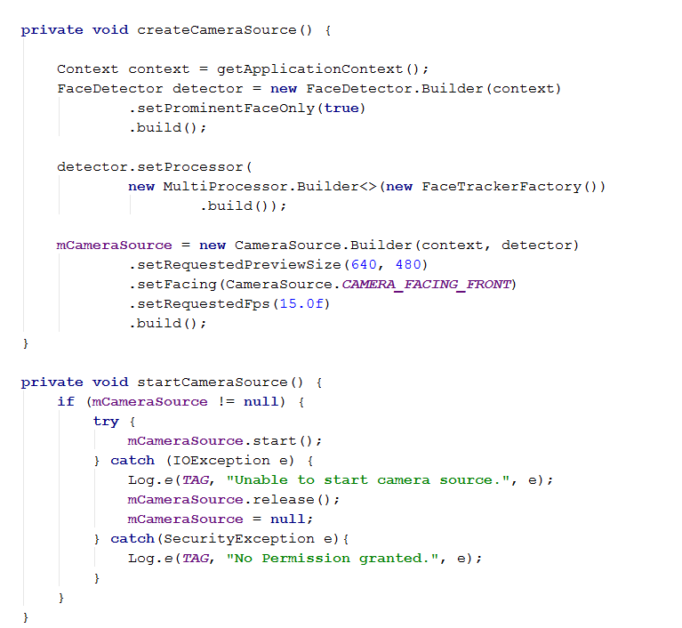
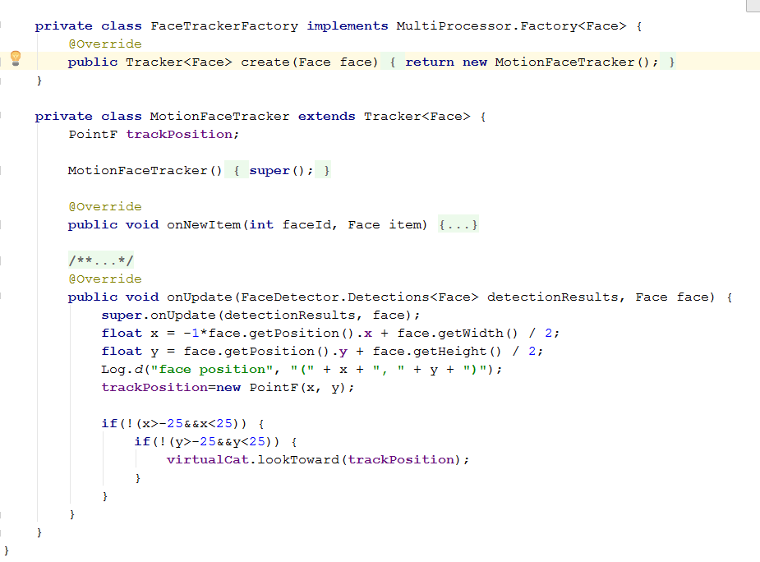

Slide 26
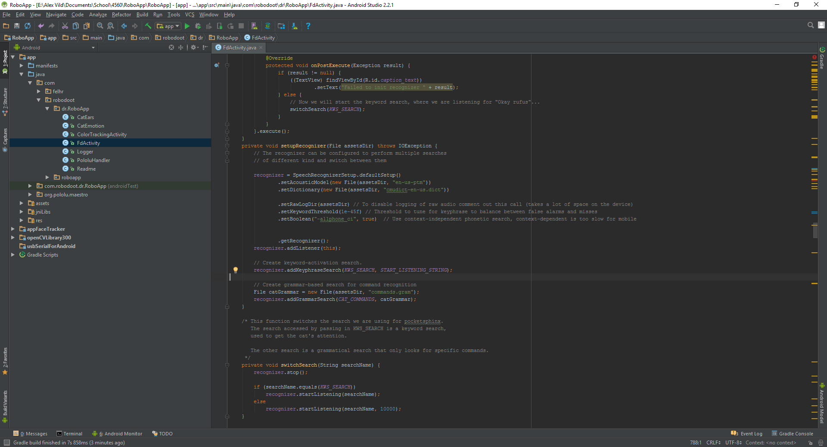
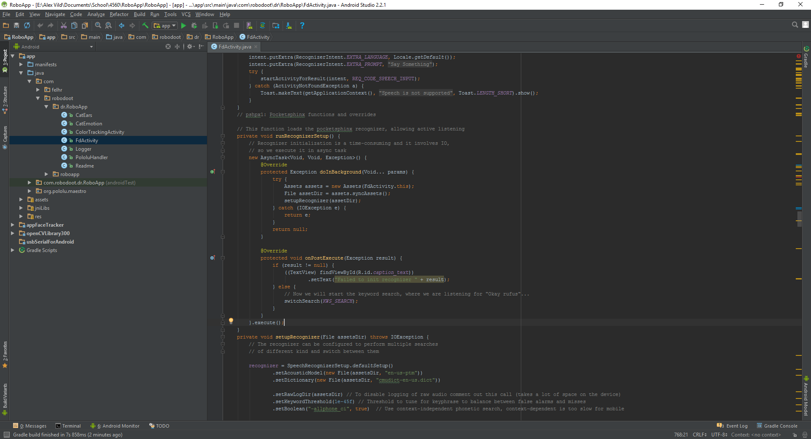
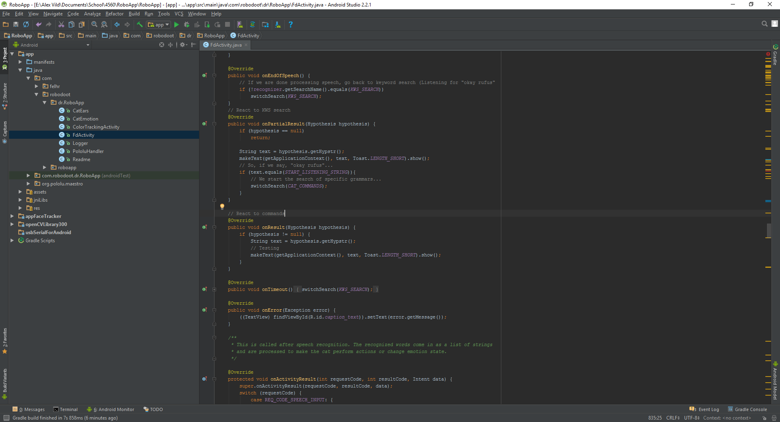
Key Code - Voice

Slide 27
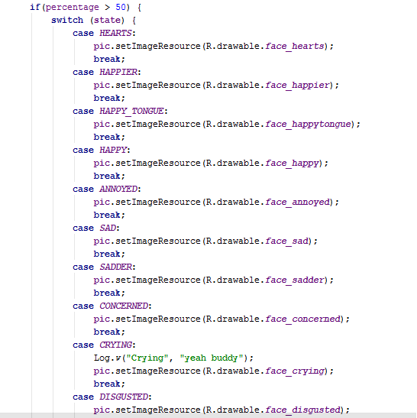
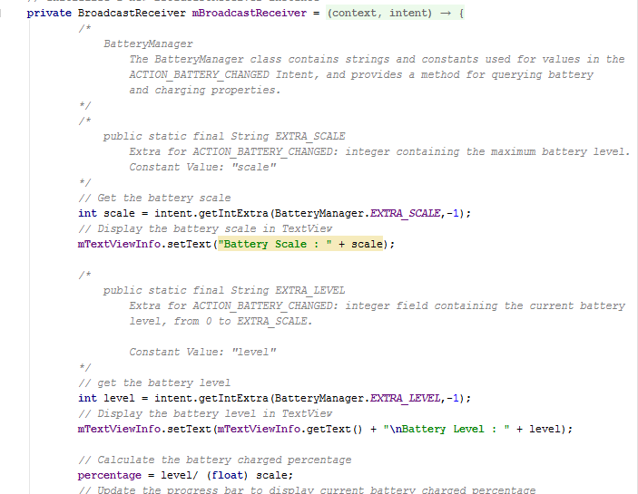
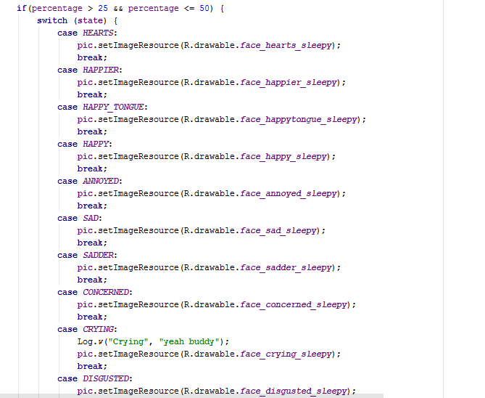
Key Code - Battery

Slide 28
System Architecture
RoboApp is written using AndroidSDK
The code within the project is written in Java and Matlab. We will mainly be using the Java code.
The app is deployed to the phone, then the phone, with the app running is connected via usb to the cat and mounted on the cat to serve as its “head.”
There are 4 main modules: Face Tracking, Color Tracking, Speech Recognition, and Environmental mapping.
See Diagram next slide
Notes:
Present

Slide 29
RoboApp
Android Studio
Face Tracking
Color Tracking
Speech Recognition
Environmental Mapping
Google Play Services
PocketSphinx
http://cmusphinx.sourceforge.net/
Servos
Arduino

Slide 30
Use Cases
Use Cases
RoboCat is talked to: He is being spoken to and is actively listening for a command.
Robot cat is looking for a Point of Interest (Either a person or a color)
RoboCat is looking for a person: He is looking around and searching for a face using facial recognition.
RoboCat is looking for a color: He is searching for a predetermined color and tracking its movement using color tracking.
Actors
RoboCat
User

Slide 31
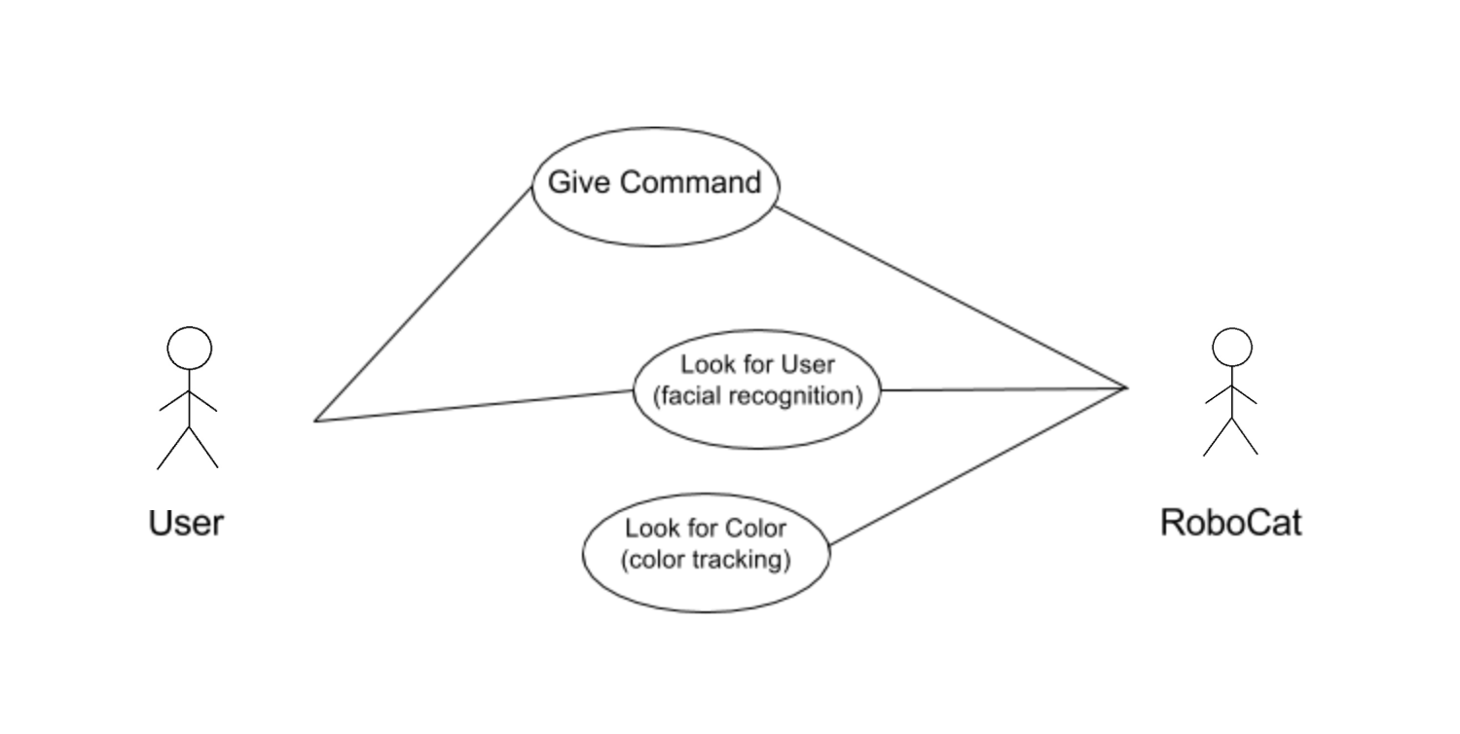
Use Cases

Slide 32
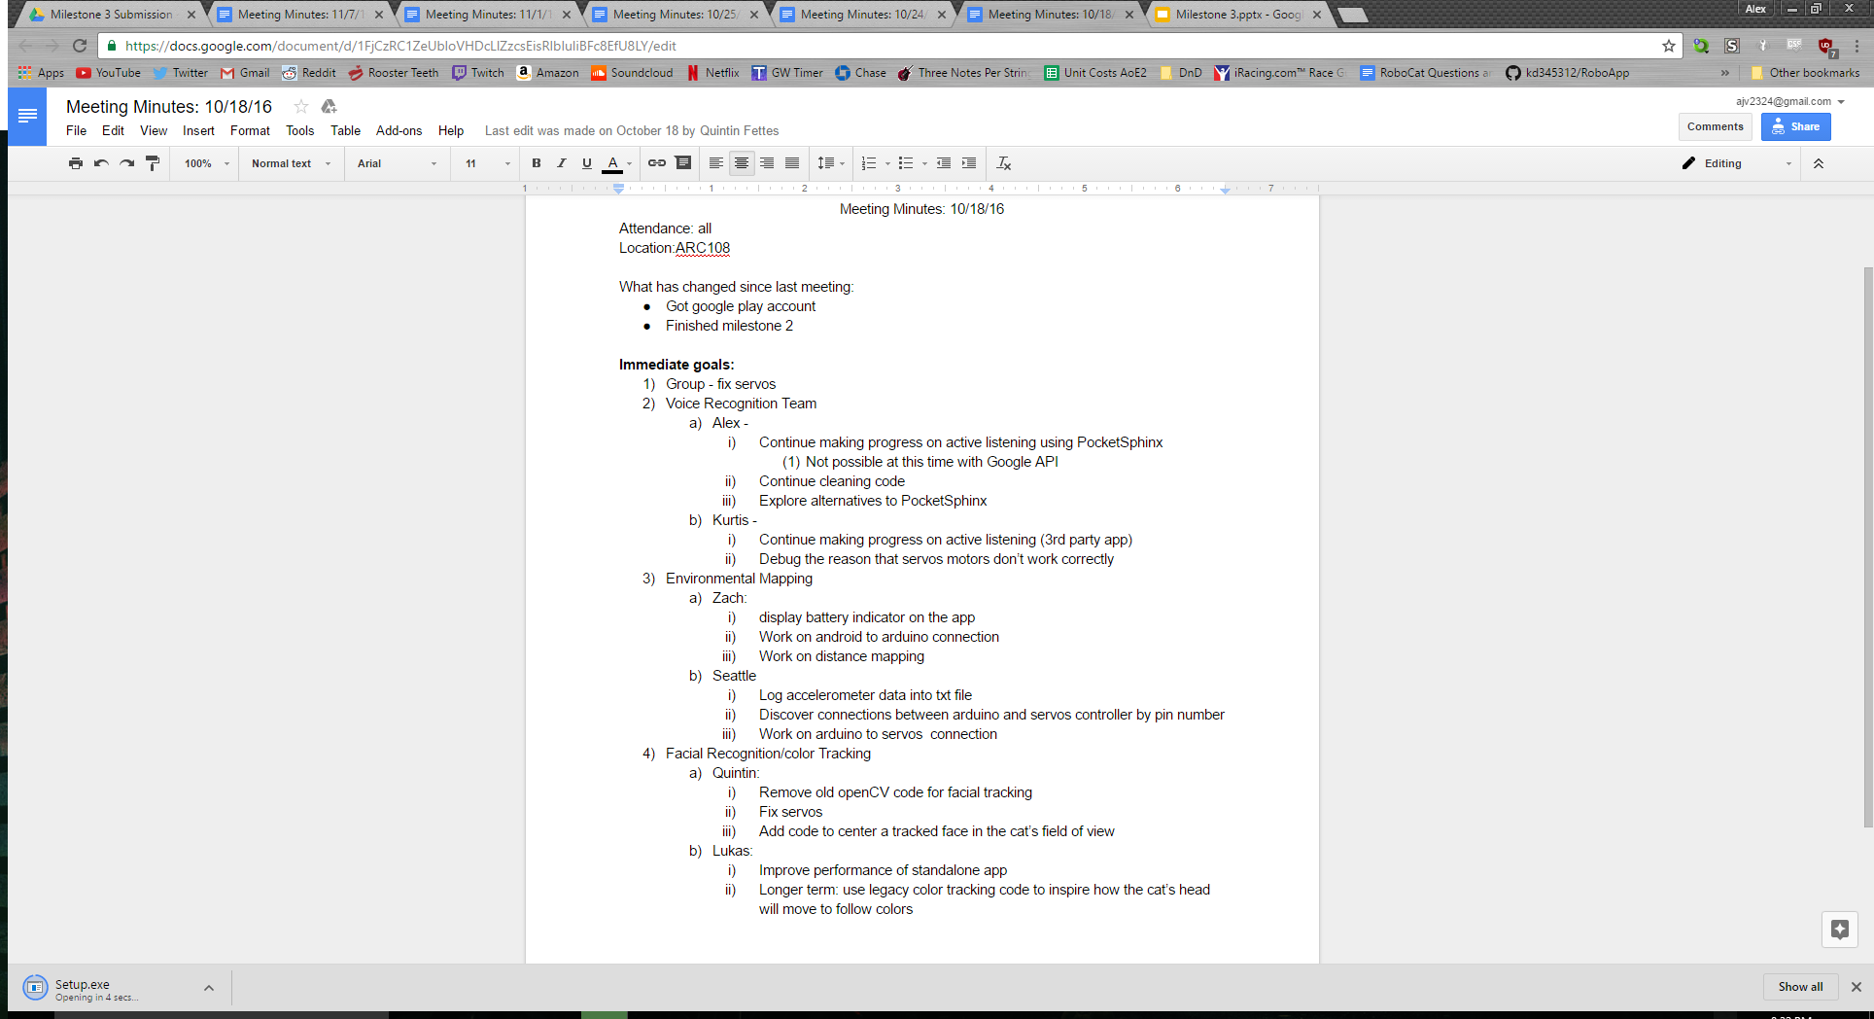
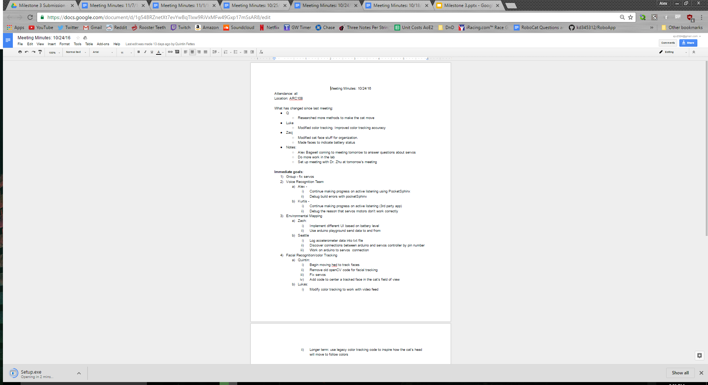

Slide 33
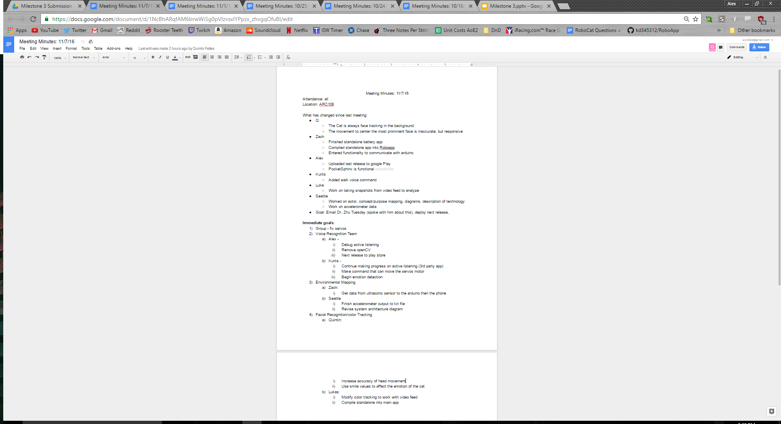
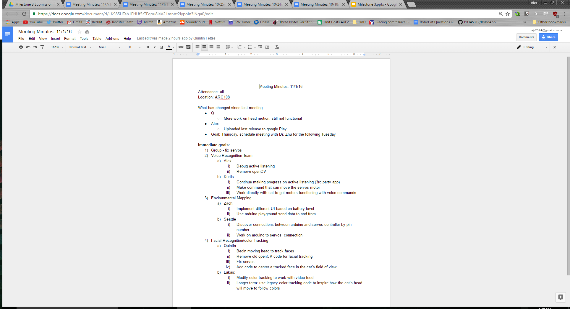
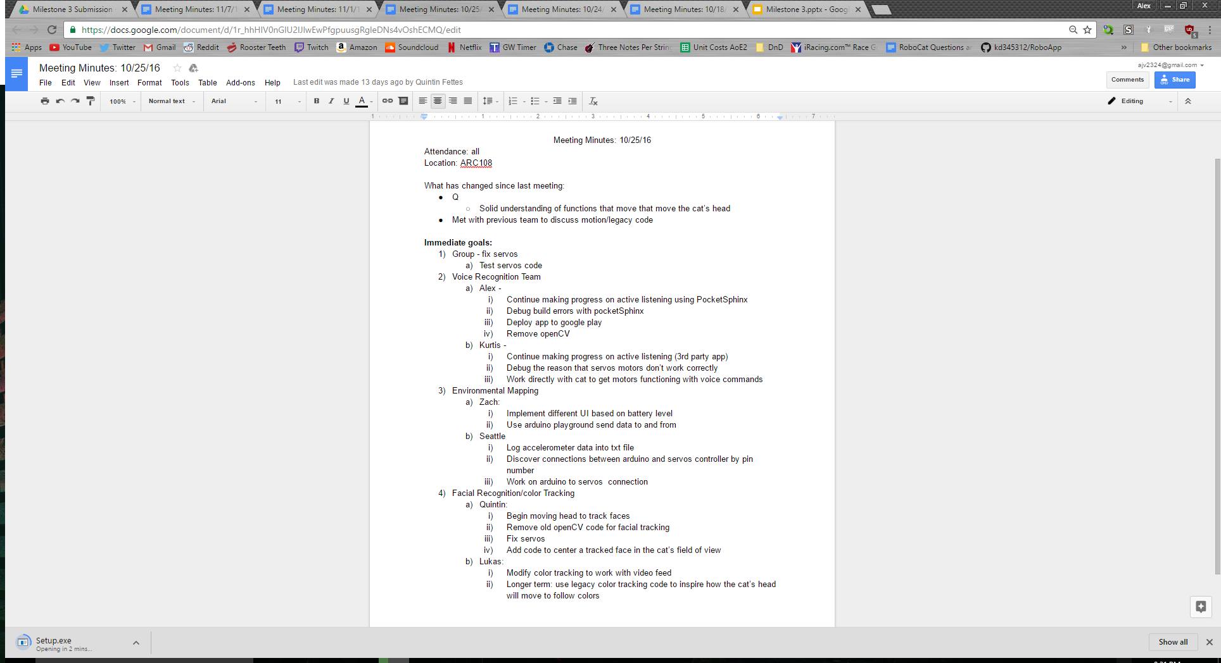
Notes:
put meeting logs in

Slide 34
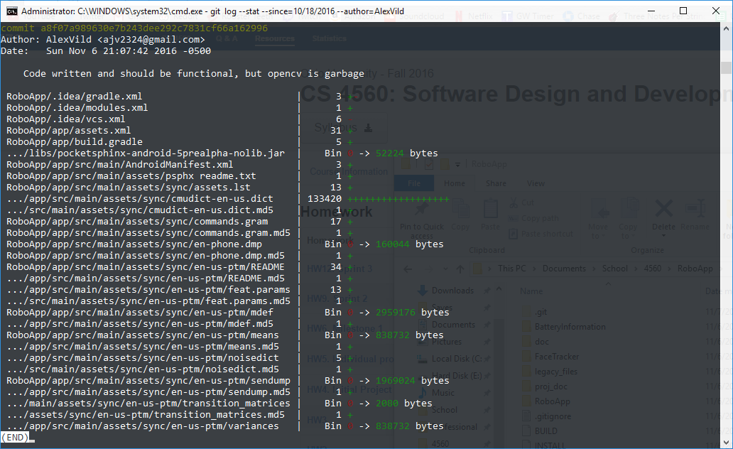
Git Log- Alex

Slide 35
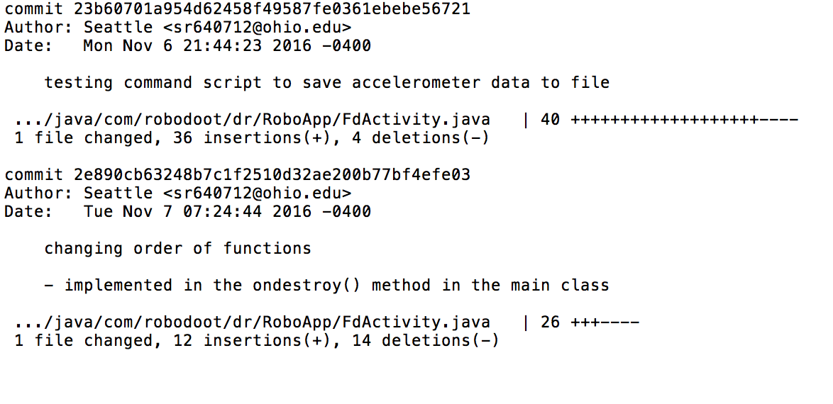
Git Log- Seattle

Slide 36
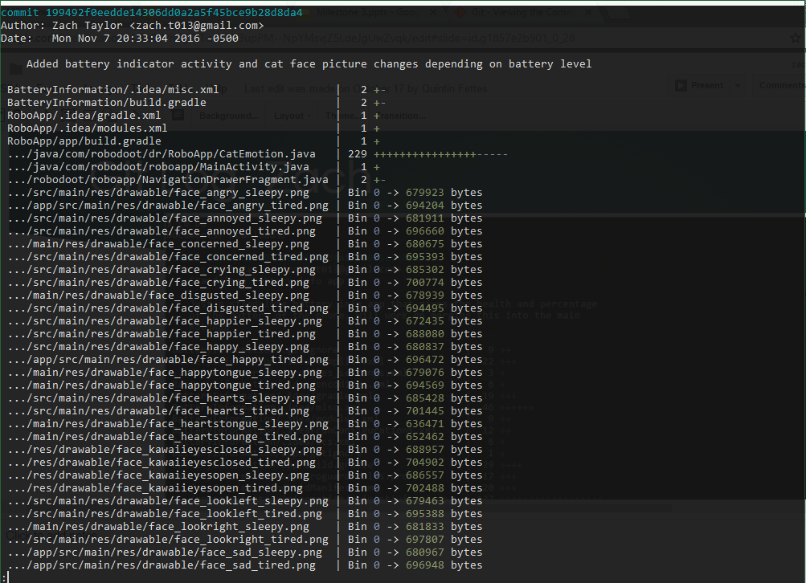
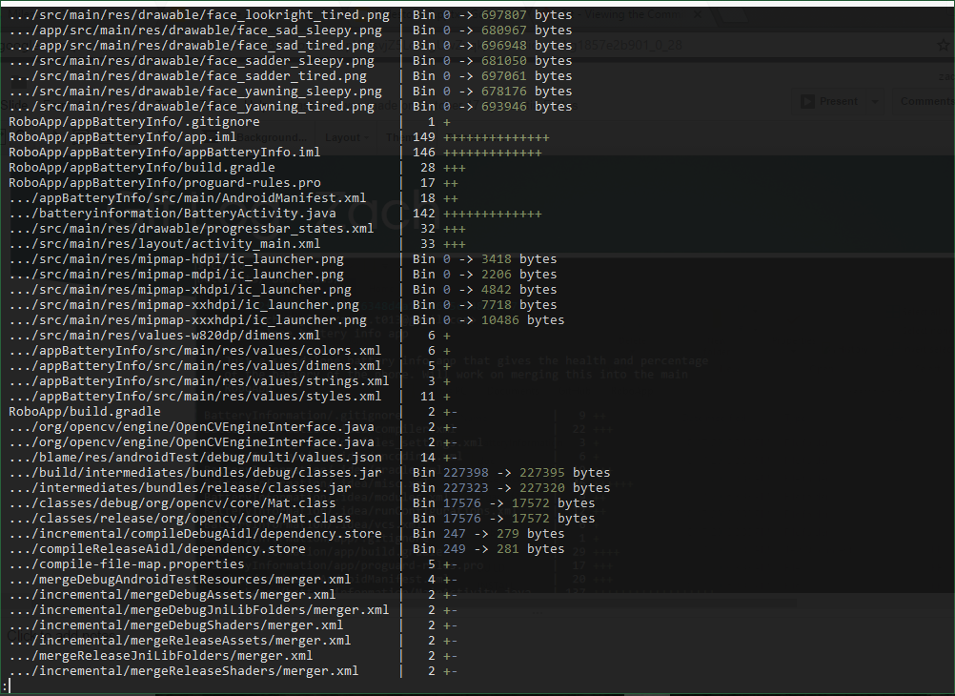
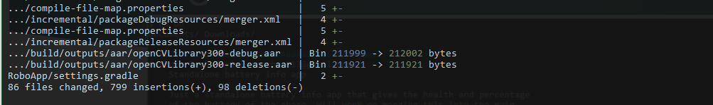
Git Log- Zach

Slide 37
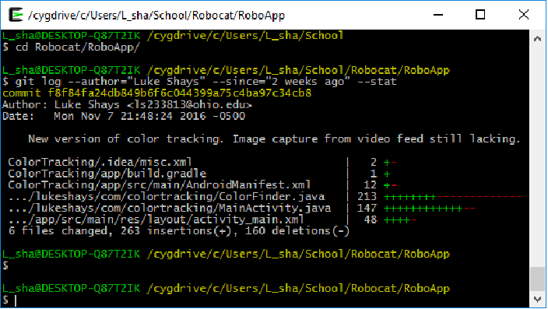
Git Log- Luke

Slide 38
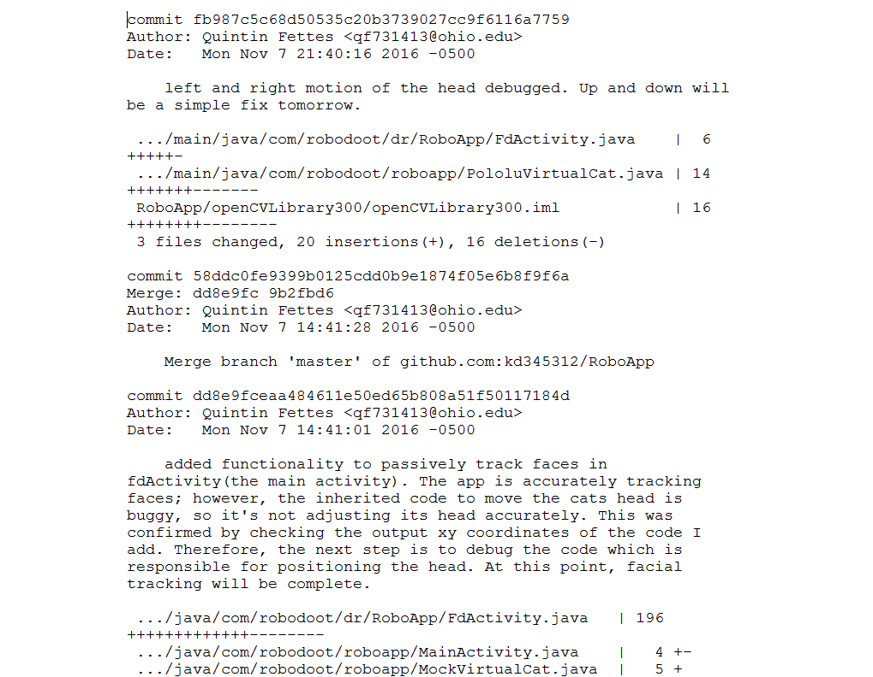
Git Log- Quintin (only most recent, others included in submit)

Slide 39
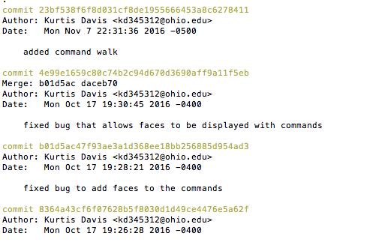
Git Log- Kurtis

Slide 40
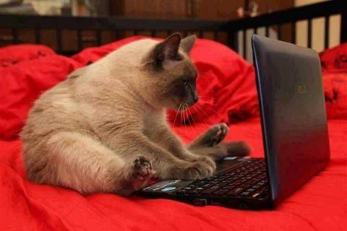
RoboCat Project
Notes:
Introduce ourselves

Slide 41
Demo (Video)

